Slide 1

THE WHITE COLLAR PROJECT HANDOVER
24TH NOVEMBER 2018
MEDIANI | RACHAEL | SUHAILAH | XIUWEN | YI JING

Slide 2



CONTENTS
Our Team and Stakeholders
Value of Project
Our Solution
Application Architecture
Project Demo
Project Management
Reflections

Slide 3
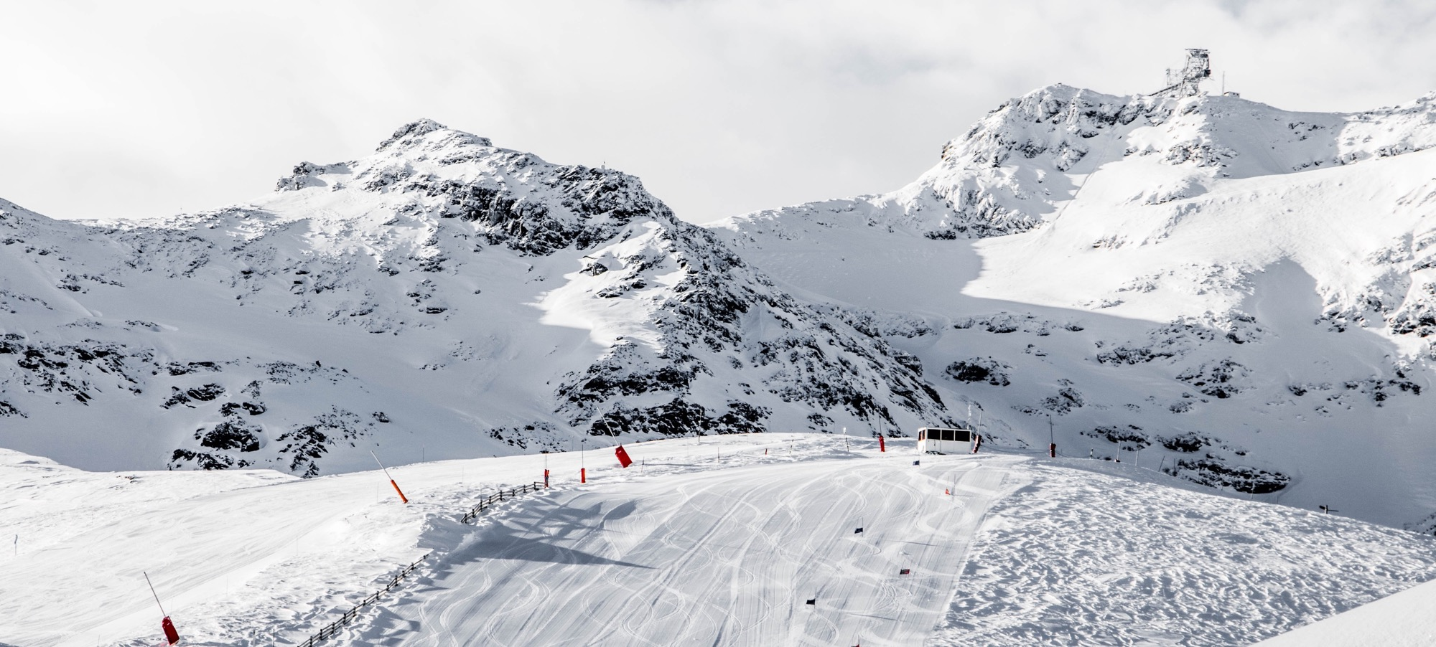
OUR TEAM & STAKEHOLDERS
KNOWING MORE ABOUT US

Slide 4
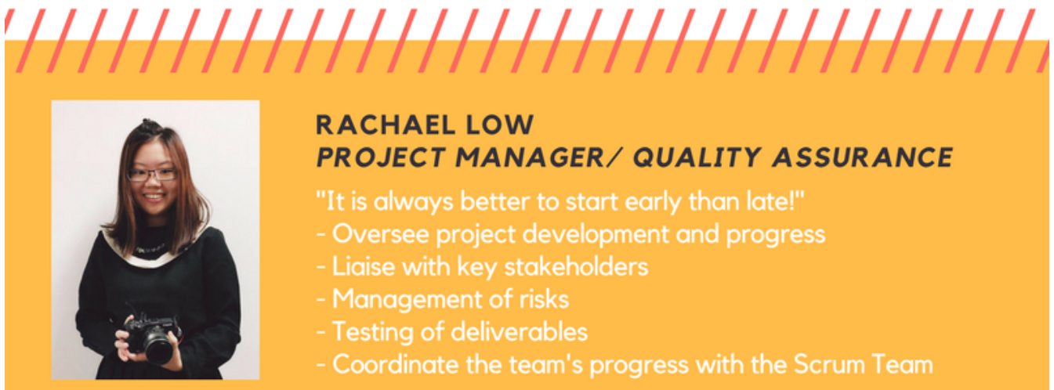

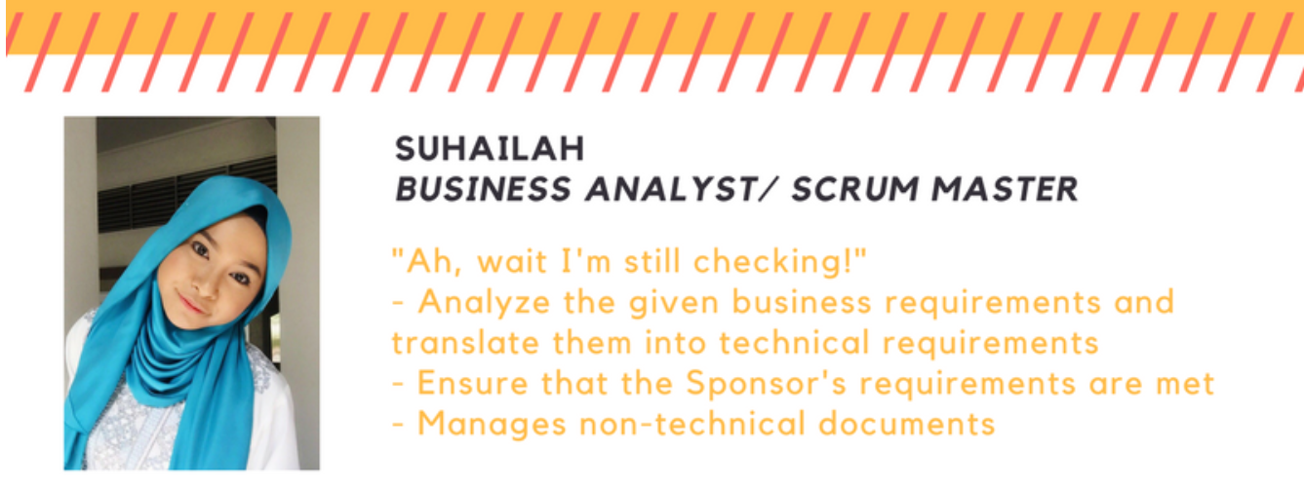
OUR TEAM – KNOWING MORE ABOUT US

Slide 5
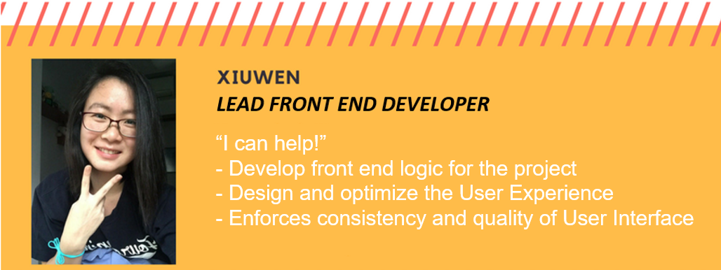
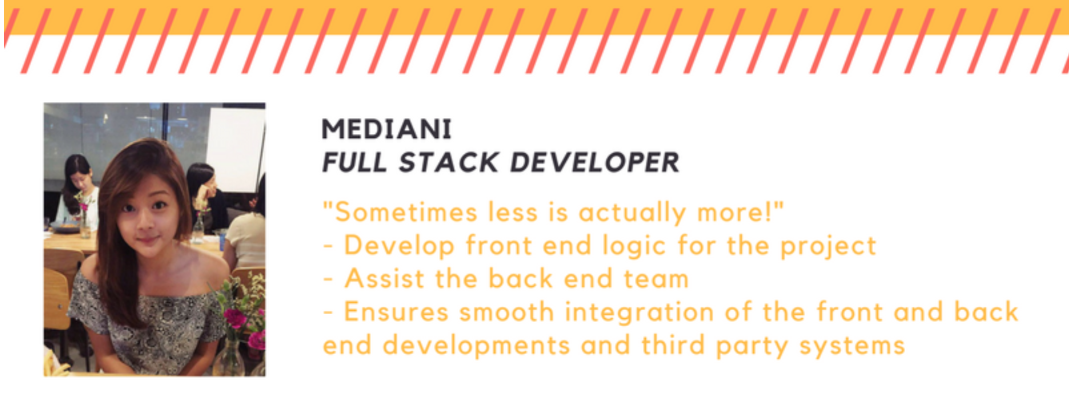
OUR TEAM – KNOWING MORE ABOUT US

Slide 6
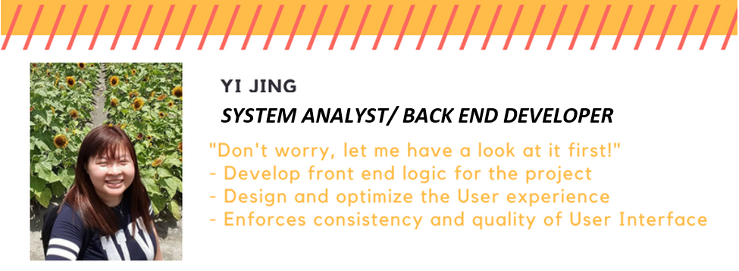
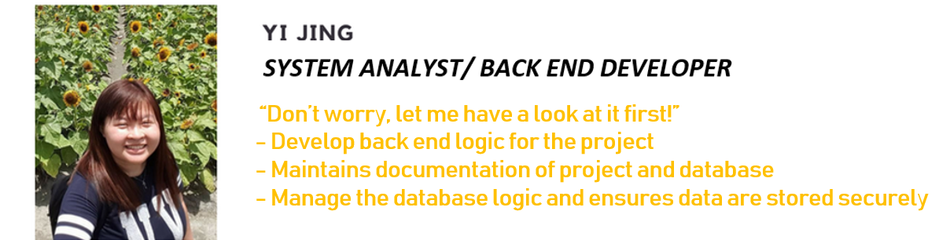
OUR TEAM – KNOWING MORE ABOUT US

Slide 7

OUR STAKEHOLDERS – KNOWING MORE ABOUT THEM
EPIC PTE LTD
Local SME providing their trainees with global exposure and entrepreneurship training. This is done through a partnership with relevant stakeholders.
Currently, their programs can be categorized into two broad groups:
(1) Overseas Study Trips and
(2) Overseas Internships

Slide 8
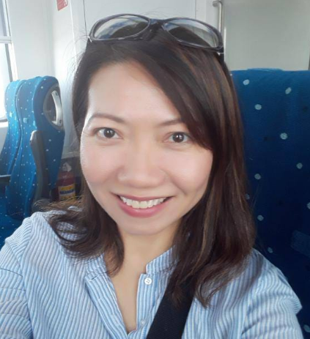
OUR STAKEHOLDERS – KNOWING MORE ABOUT THEM
MS ISABELLE LEE
PROJECT SPONSOR
Founder, Program & Business Director of EPIC PTE LTD
Work with relevant stakeholders to:
Design and plan for overseas study trips and source for overseas internship opportunities
Make business decisions and directions for her organization

Slide 9
VALUE OF PROJECT
UNDERSTANDING THE PROBLEMS AND SOLUTIONS

Slide 10





OUR USERS – UNDERSTANDING OUR CLIENTS
STUDENTS, GRADUATES, WORKING ADULTS
EPIC ADMINSTRATOR
EPIC Service Partners
Our primary users will be users who will utilise our web application to search and register for programmes offered by EPIC.
Our secondary users will be the administrators who are in charge of the managing the programmes and the people who registered for the programmes.
Our secondary users will be the service partners who work closely with EPIC to run the programmes. They will utilise our system to more effectively collaborate with EPIC.

Slide 11


MOTIVATION – UNDERSTANDING THE REASONS
Empower EPIC to have an improved collaboration channel to create more business opportunities with their service partners worldwide
Increase EPIC’s outreach and help more people to gain crucial global exposure

Slide 12



PROBLEMS – UNDERSTANDING THE CAUSES
Difficulties in
Reaching Out to Customers
Heavy Reliance on Manual Processes
Time consuming
Lack of brand awareness
Limited outreach to people
Time consuming
Inconvenient for customers to fill up contact information in sign-up forms
Record keeping: manually keyed in Microsoft Excel

Slide 13

PROBLEMS – UNDERSTANDING THE CAUSES
Lack of collaborative platforms between business partners
Static business website
Communicating business via email and Whatsapp
No shared platform to conduct business with partners
Purely information sharing with no pricing
No automated processes
Inconvenient and inefficient as all processes are done through “Contact Us”

Slide 14
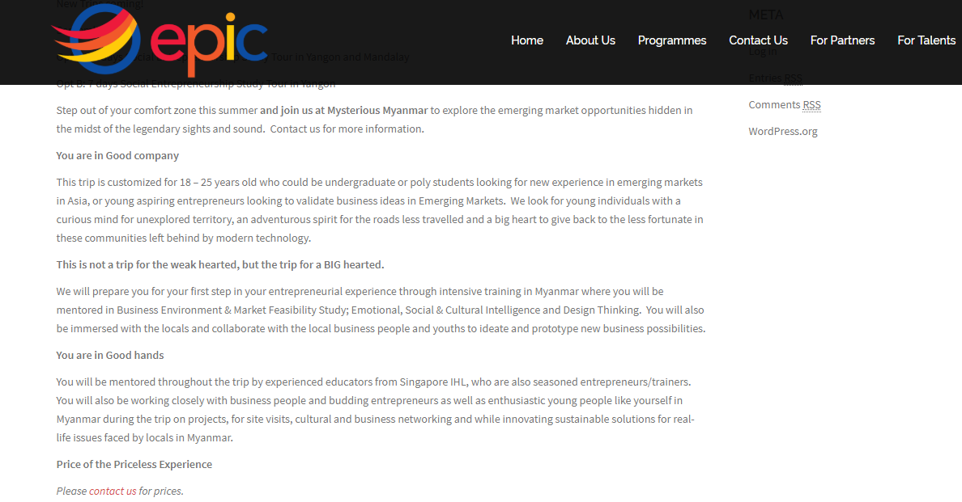
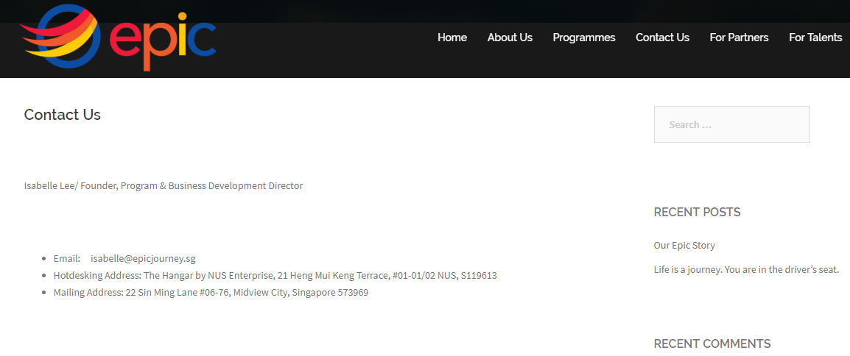
PROBLEMS – UNDERSTANDING THE CAUSES
Static business website

Slide 15
OUR SOLUTION
SOLVING THE PROBLEMS

Slide 16

OUR SOLUTION – SOLVING THE PROBLEM
Platform for communication and collaboration among admin, partners and users
Easy modifications of recommended itineraries, offering a user friendly interface for the admin
CUSTOMISED
WEB APPLICATION
CRUD of users and admin accounts
Content Management System (CMS) to promote one-to-one marketing for users based on information provided by users or gathered by the site
Tracking of application progress and transactions

Slide 17


OUR SOLUTION – SOLVING THE PROBLEM
CUSTOMISED WEB APPLICATION
PROBLEMS:
Only able to display static information as EPIC do not have the IT expertise to take in non-static information
Unable to have customised functions to suit the business needs
Visual Appeal - Innovation to capture EPIC’s audience
Branding - Readable content, Higher conversions
Flexibility - Able to scale with the business
Improved Customization - Customizing website on an ongoing basis

Slide 18


VALUE PROPOSITION – KNOWING WHERE WE STAND
POWER OF COLLABORATION
No specific platform exists in the market today that provide admin with a collaborative platform to connect with both the users and also the service partners.
POWER OF LEARNING EXPERIENCES
Just like Anywhr and Flying Chalks, we provide our administrators with an interactive platform to easily add and make amendments to a study trip/internships to maximise learning for the participants.

Slide 19
APPLICATION ARCHITECTURE
UNDERSTANDING THE SYSTEM

Slide 20













TECHNOLOGIES USED – UNDERSTANDING THE SYSTEM
CLIENT SIDE
SERVER SIDE
DEVELOPMENT LANGUAGE
DATABASE
PROJECT MANAGEMENT
REPOSITORY
IDE

Slide 21

ARCHITECTURE DIAGRAM – UNDERSTANDING THE SYSTEM
CLIENT TIER
HTTP
APPLICATION TIER
HMTL/CSS/Javascript
JSP
JSON (API)
Presentation Layer
Account Module
Admin Module
User Module
Business Layer
Study Trip Module
Service Partners Module
Internship Module
DATA TIER
DATABASE

Slide 22

PROJECT DEMO
LETS COME ONBOARD ON THE EPIC JOURNEY
Notes:
© Copyright Showeet.com – Free PowerPoint Templates

Slide 23
VISUAL CMS – GETTING TO KNOW THE SCENARIO
PRIMARY USERS
Students, Graduates, Working Adults
SECONDARY USERS
EPIC ADMINISTRATOR
Planning and adding study trips
Managing internship postings
Managing users
Managing service partners
Source for interns
Creating an user account
Applying for study trips
Applying for internships
SECONDARY USERS
SERVICE PARTNERS
Creating a user account
Upload new internship positions and roles
Indicate collaboration interest

Slide 24

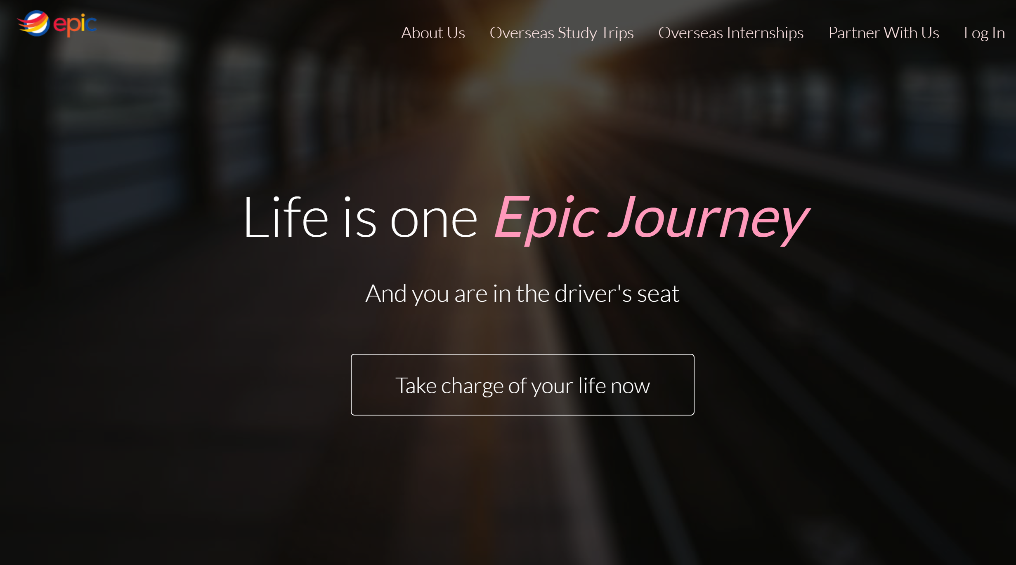
PROJECT DEMO – STARTING ON OUR EPIC JOURBEY

Slide 25
PROJECT MANAGEMENT
OUR PROGRESS
Notes:
© Copyright Showeet.com – Free PowerPoint Templates

Slide 26
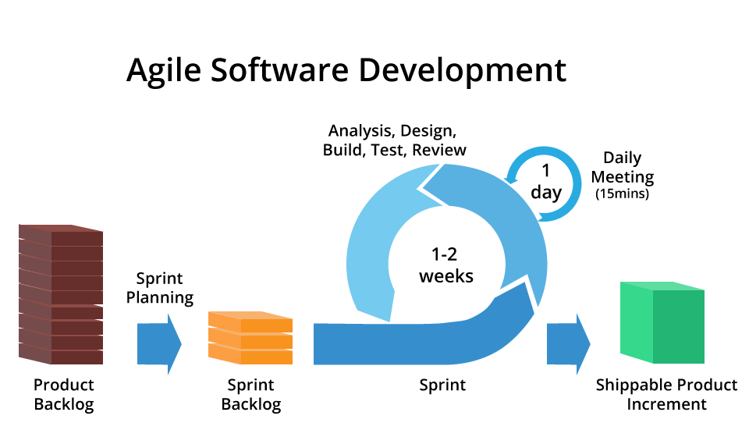
METHODOLOGY – SCRUM FRAMEWORK
MODIFIED SCRUM APPROACH
Unable to have a daily scrum meeting
AGILE APPROACH
2 week sprints
At the end of each sprint, sprint review is conducted and new functionalities are shared with the stakeholders
Feedbacks are accepted and provided

Slide 27
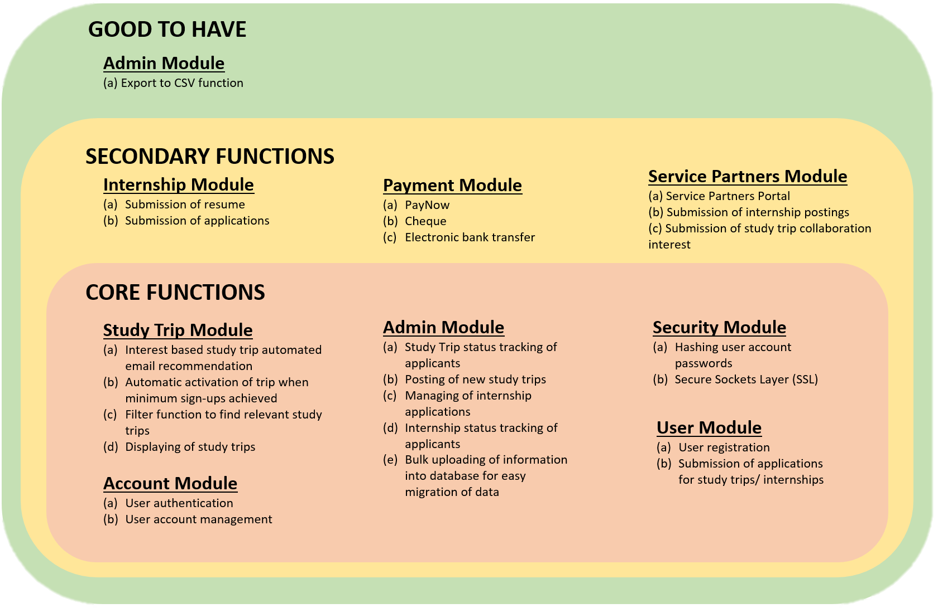
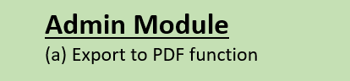
PROJECT SCOPE – PLANNED

Slide 28
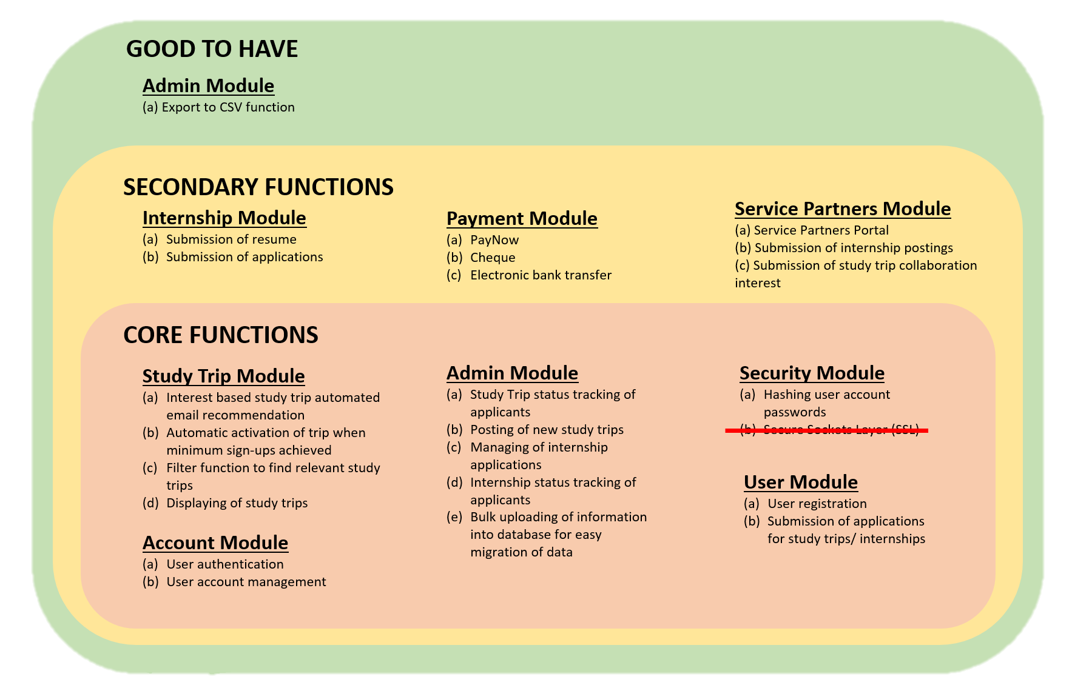
PROJECT SCOPE – CURRENT

Slide 29
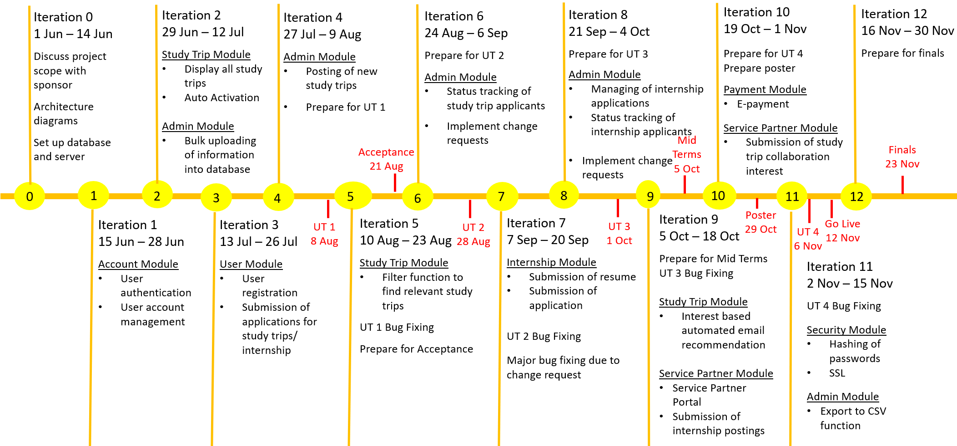
PROJECT TIMELINE – PLANNED

Slide 30
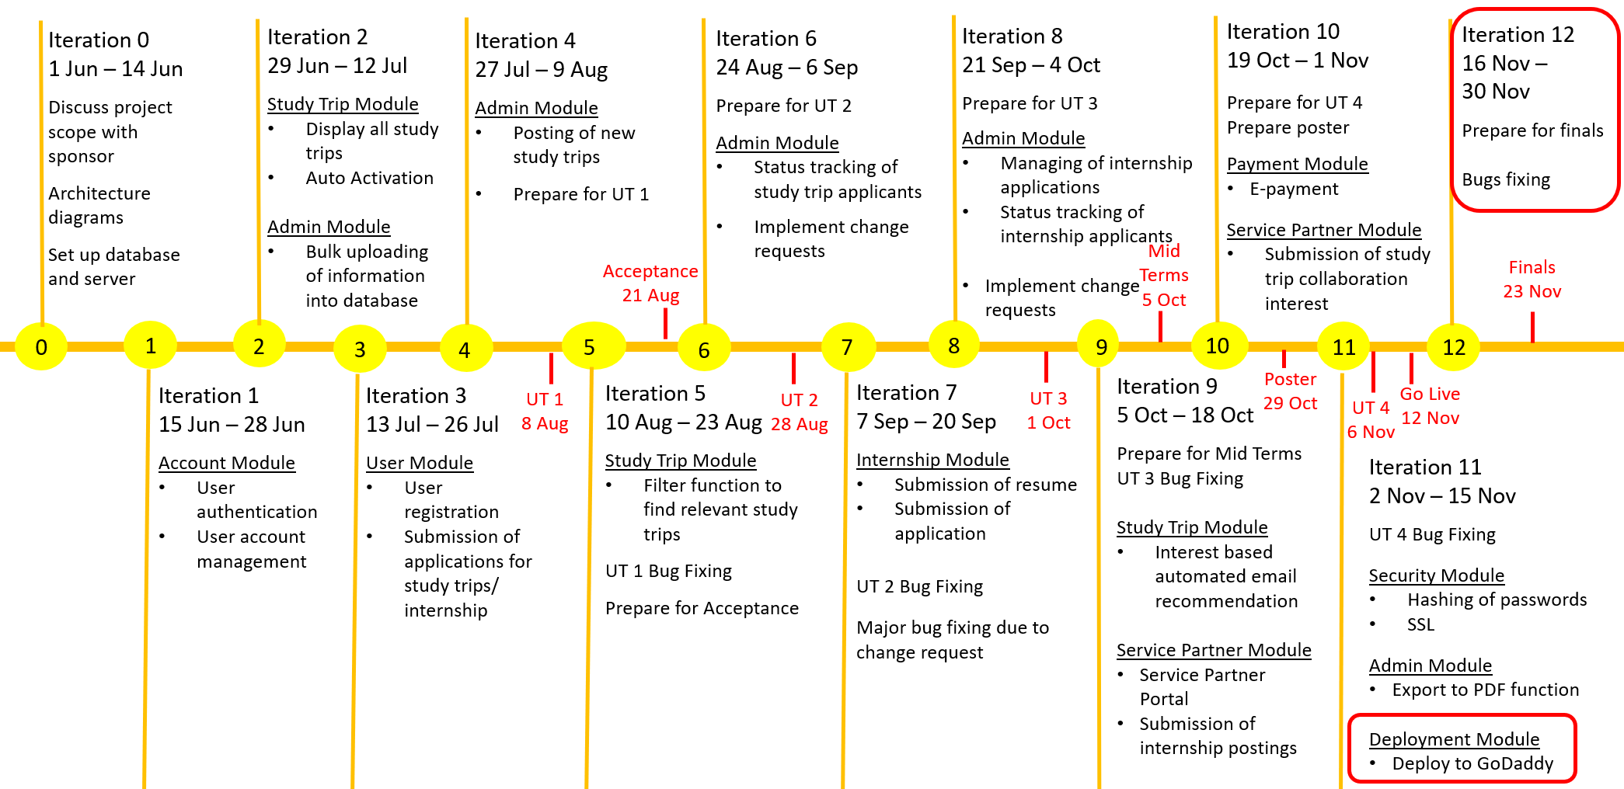
PROJECT TIMELINE – CURRENT

Slide 31
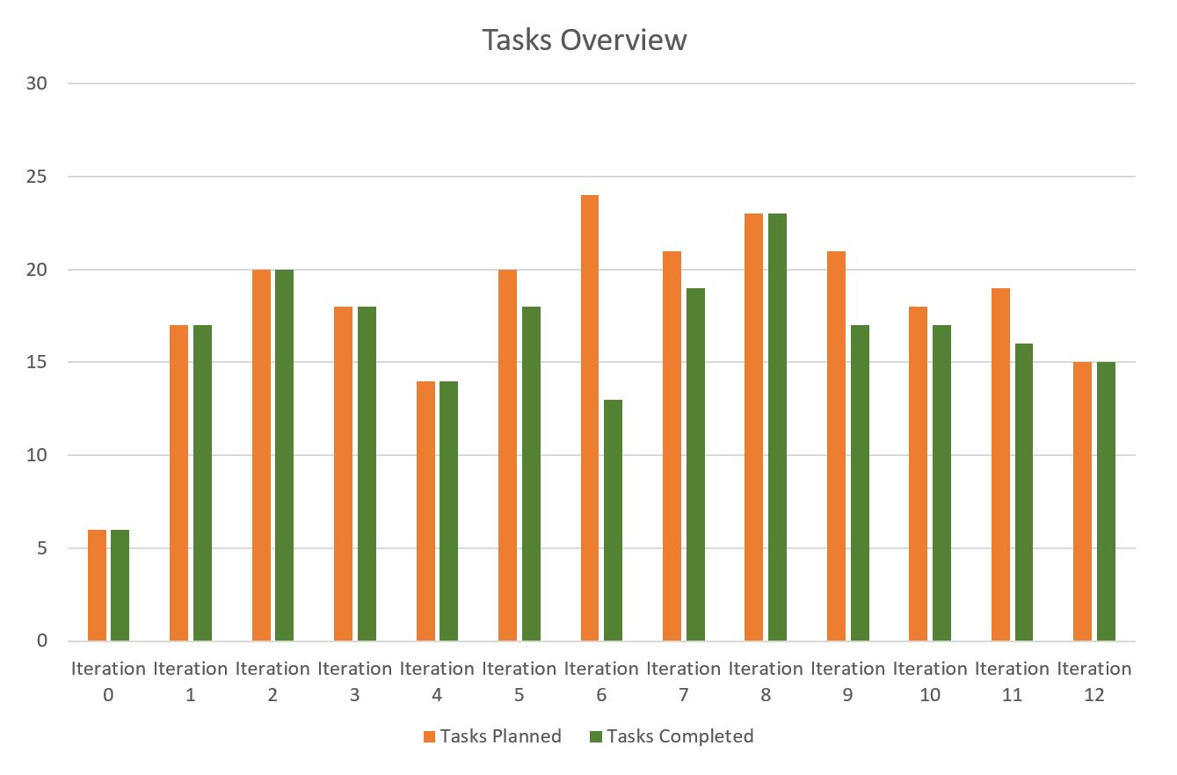
TASK OVERVIEW – CURRENT

Slide 32
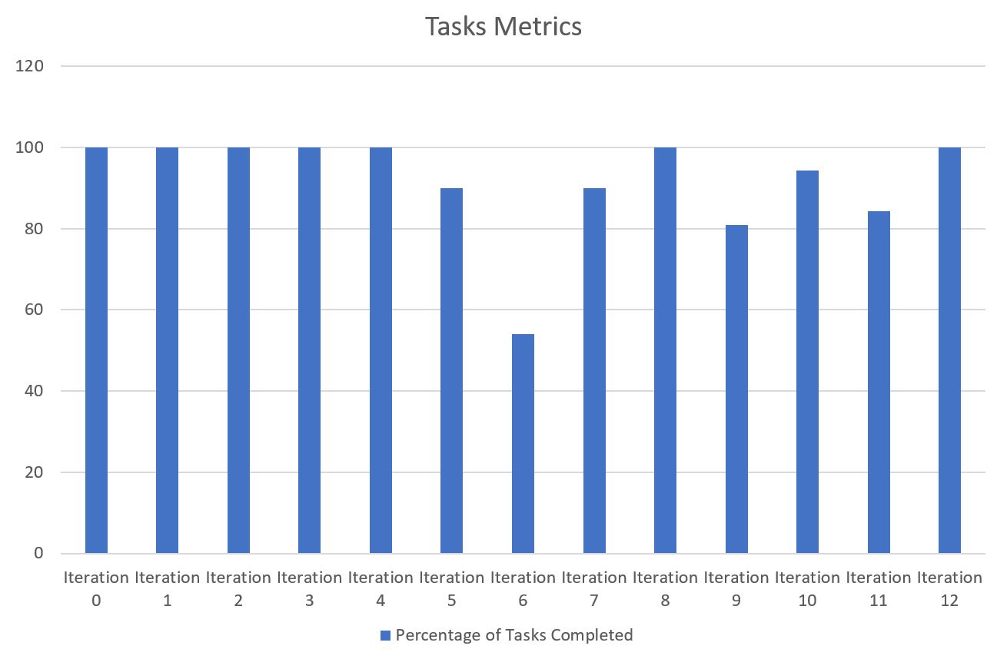
TASK SCORE – CURRENT

Slide 33
TASKS LOG – ITER 6
Iteration 6
Date | Task | Type | Completed?
25/08/2018 | Change of database fields – Adding of Field of Study and Interests | Programming | No
27/08/2018 | Admin Module- Approval of interest based matching based on interest | Programming | No
03/09/2018 | Regression Testing | Programming | No
05/09/2018 | Solve bugs in Updated Bug Metrics | Programming | No
05/09/2018 | Solve bugs in Study Trip Module | Programming | No
Planned Tasks | 24
Actual Tasks | 13
Total Incompleted Tasks | 11
Task Score | 54

Slide 34
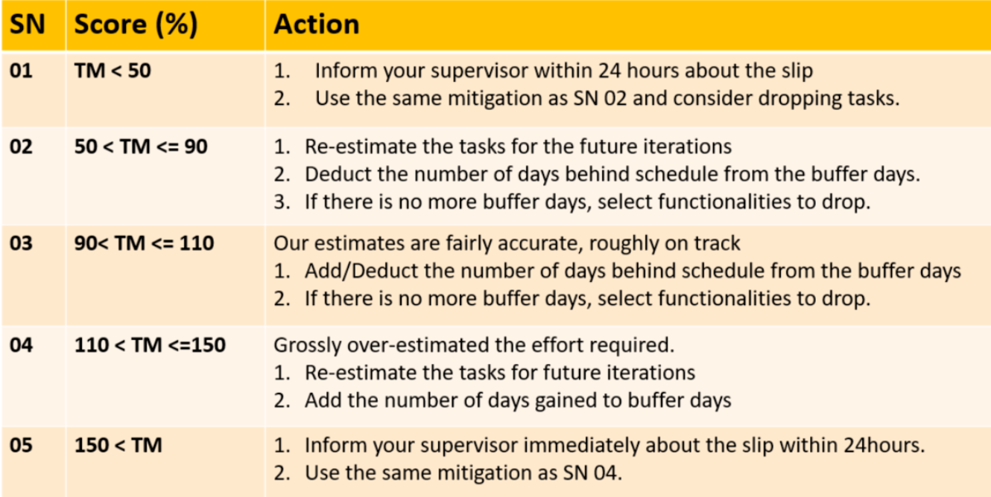
ACTION PLAN – ITER 6

Slide 35
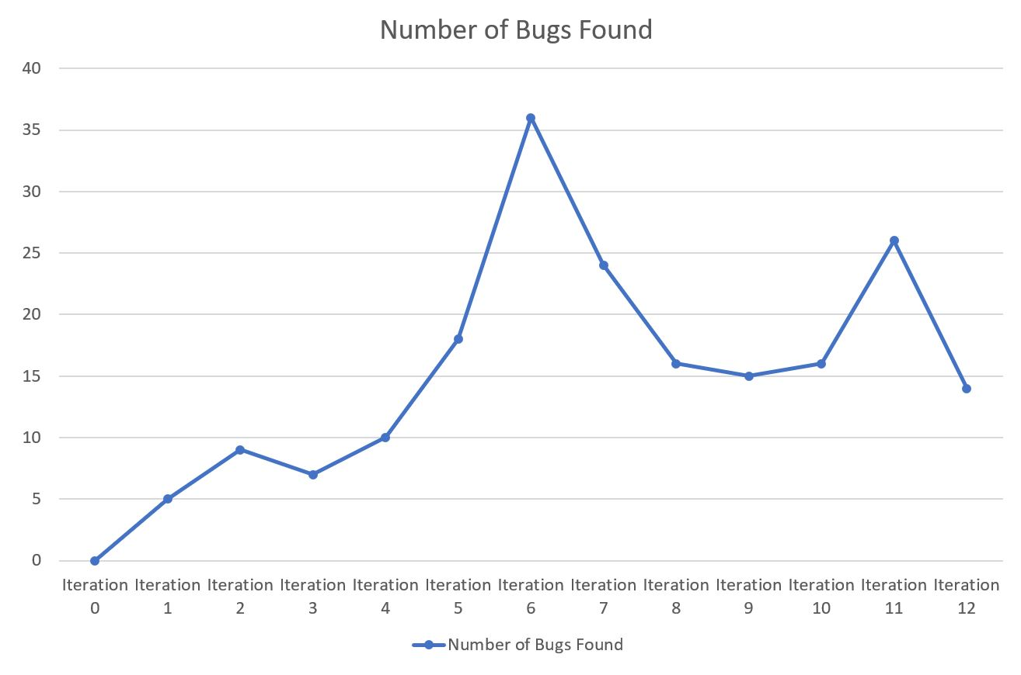
BUG METRICS – CURRENT

Slide 36
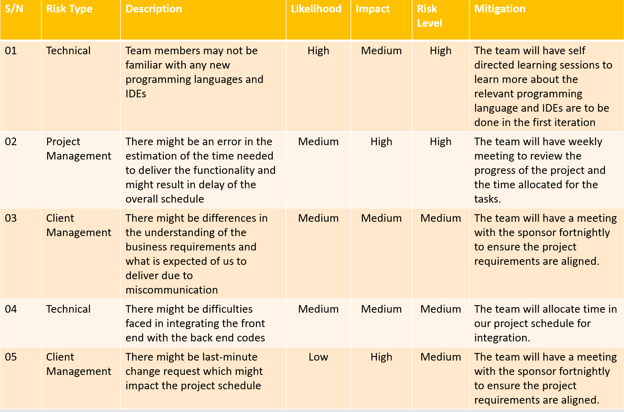
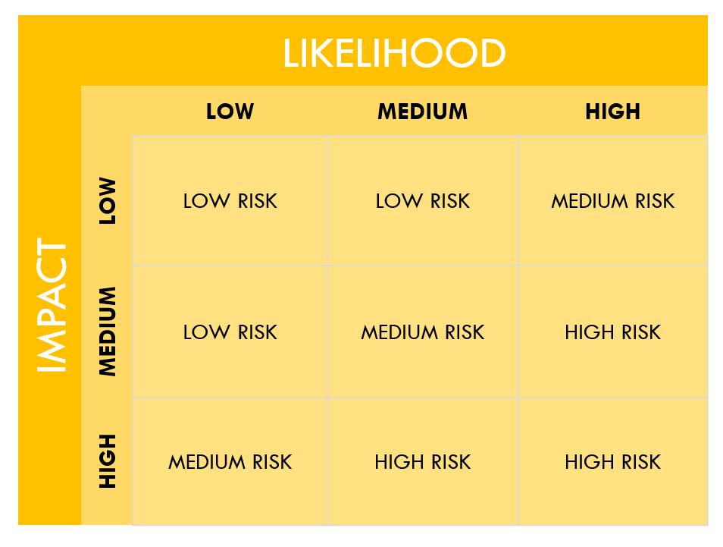
RISK MANAGEMENT
RISK CATEGORY TABLE

Slide 37
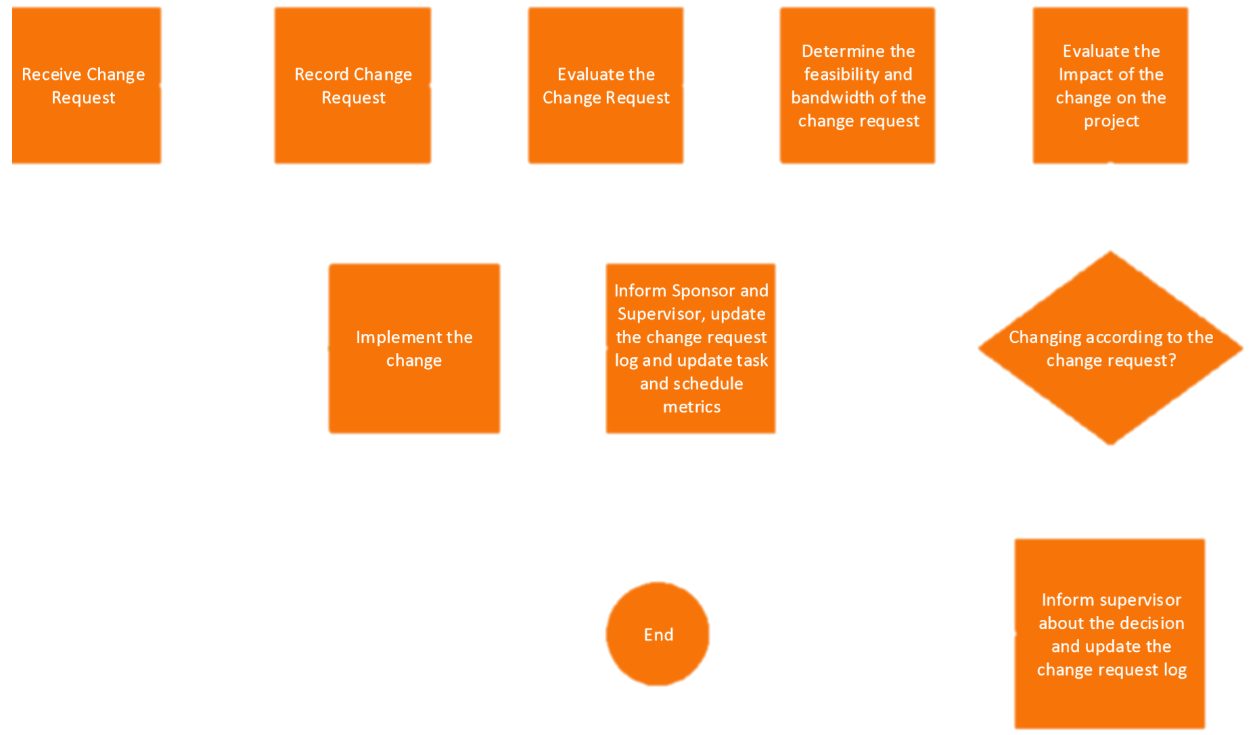
CHANGE MANGEMENT
YES
NO

Slide 38
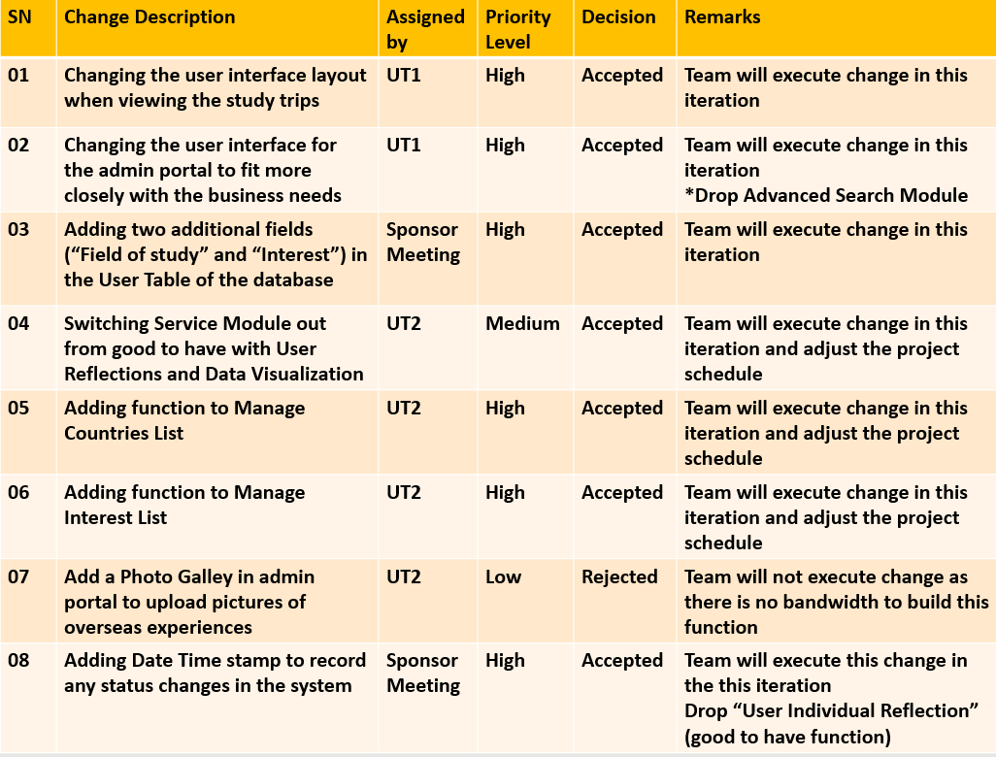
CHANGE REQUESTS

Slide 39
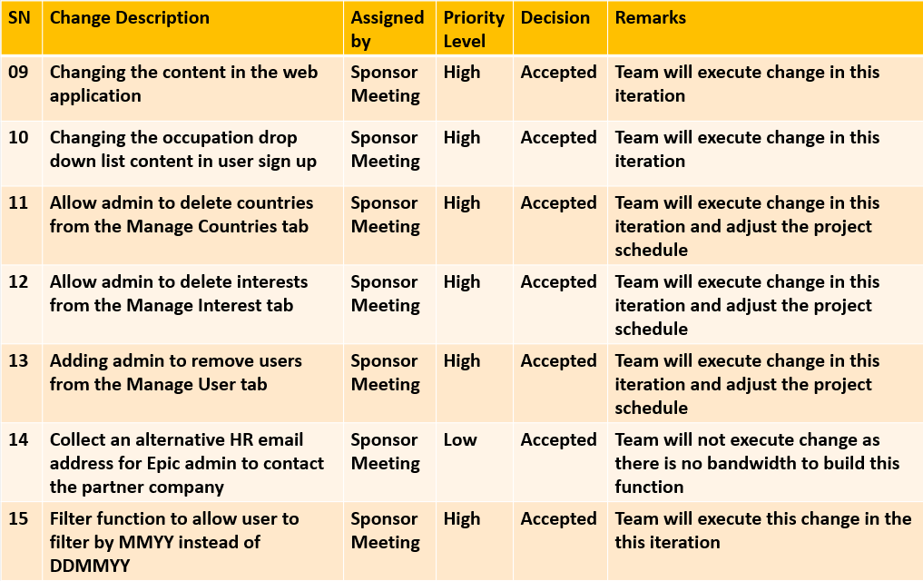
CHANGE REQUESTS

Slide 40
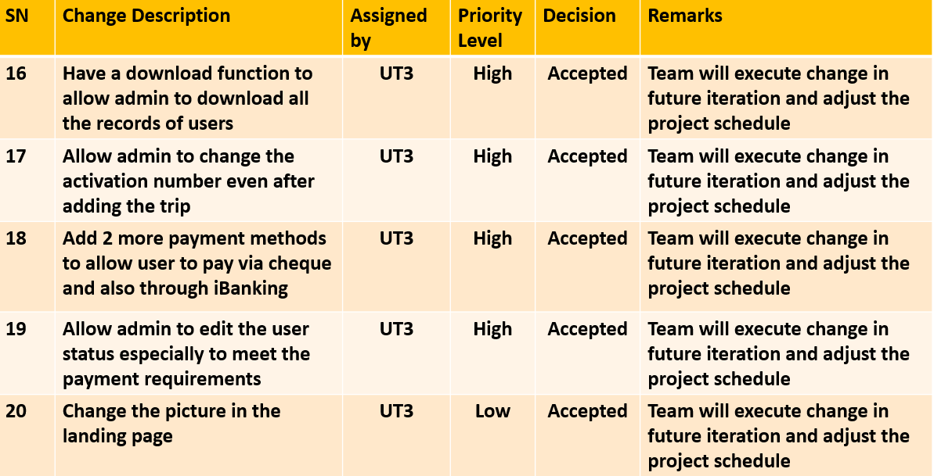
CHANGE REQUESTS

Slide 41
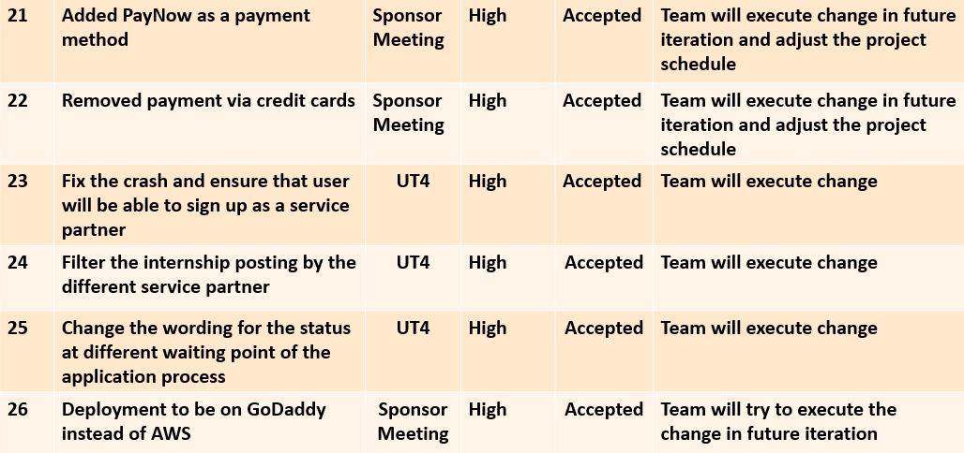
CHANGE REQUESTS

Slide 42
REFLECTIONS
OUR LEARNING PROCESS

Slide 43

RACHAEL PROJECT MANAGER
When my team members voted me to be the Project Manager, I was nervous at first. But as we go along, I am grateful to be one as this journey has taught me to use time management techniques, fulfil project requirements and most importantly develop a bond between my team and sponsor. With the growing challenges my team faces throughout my project, it is important for me to keep my team’s motivation high! I always make sure that I gather my team immediately when decisions have to be made, because I believe that wrong decisions made early can be salvaged, but 'right' decisions made late cannot! From the initiation of the project to the milestones along the way, I have enjoyed the challenge of being a Project Manager!

Slide 44

mediani full stack developer
This project gives me the opportunity to learn and grow as a developer. As a backend developer, I learned a lot of technical skills, develop the backend logic, and how to integrate front-end and backend. Despite facing several technical complexities, I had a lot of fun throughout my learning. On top of that, as I managed the integration of the front and back end developments, I get my hands dirty on Front-end and I understand real-time communication better now. I like to first consider what the web application does and then build out the business logic that it will use to accomplish this. Overall, it has been a satisfying experience, especially when the web application works smoothly. There is so much try and errors just to optimize the web application for speed and efficiency! But, all the efforts paid off!

Slide 45
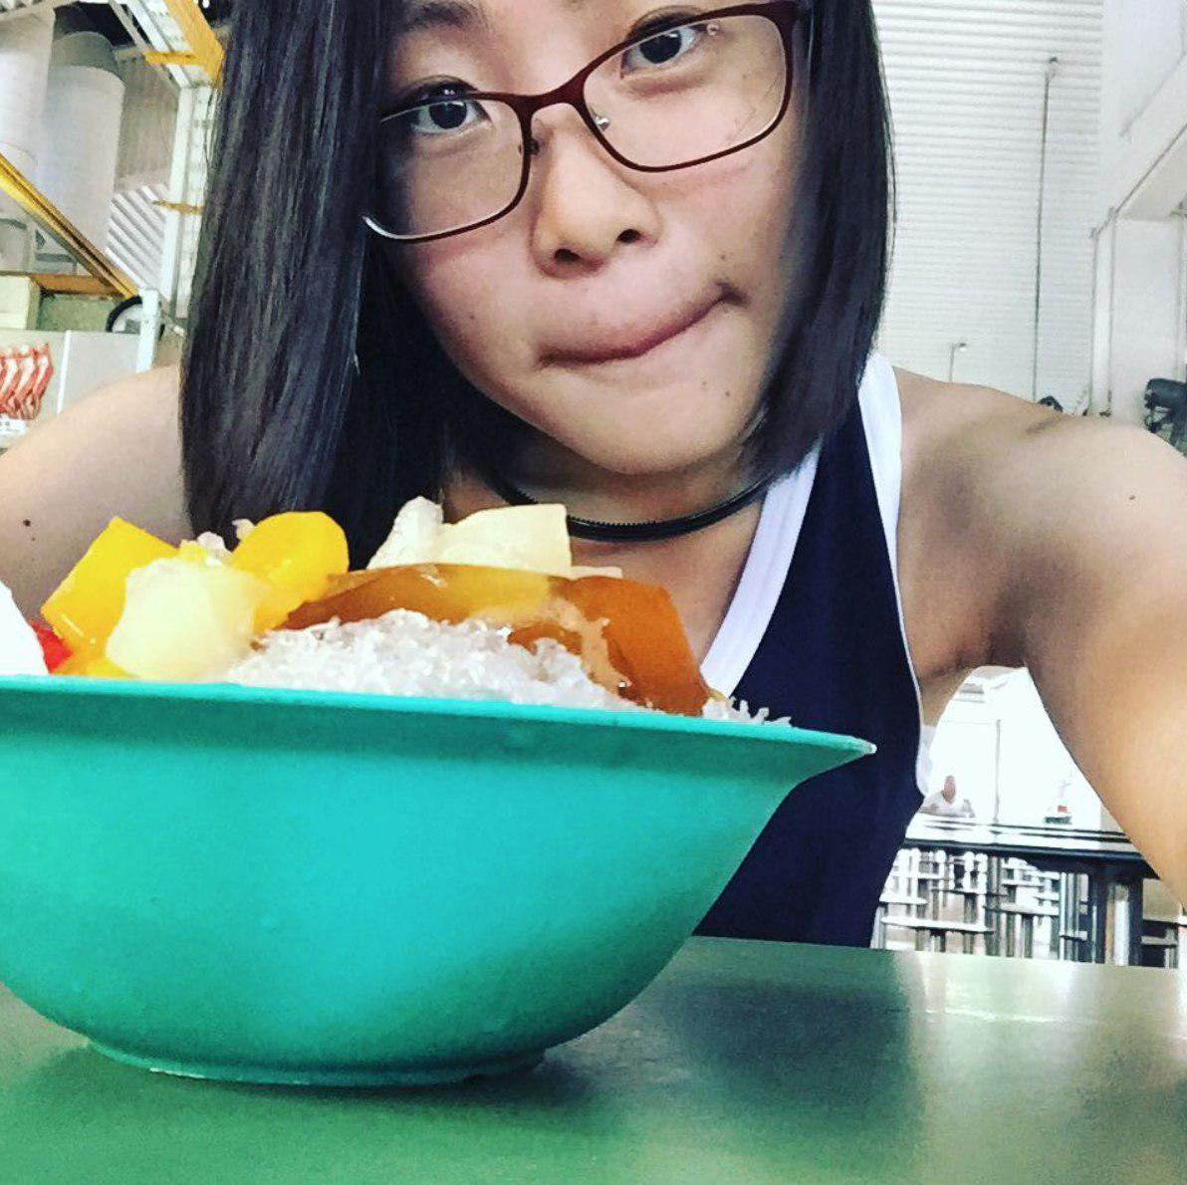
Xiu wen front end developer
As a lead front end developer, I learn to use HTML, CSS, and JavaScript to code the website and web application designs! I desperately want to get good at writing tests and developing in a more test-first manner. I have always wanted to work in an environment where code quality is valued and prioritized. I also spend most of my time debugging because I want to ensure that there are no errors or bugs on the front end. I also make sure that the design appears as it’s supposed to across various platforms and browsers. I organize my stylesheets with sections for each site component, and I practice coding commenting so that it will be easier for the other developers to work with. I enjoyed doing this project because it is, in a way, my first real art for a purpose. Everything else I’ve done is because I have an idea. But this project…this project had a message for a cause!

Slide 46
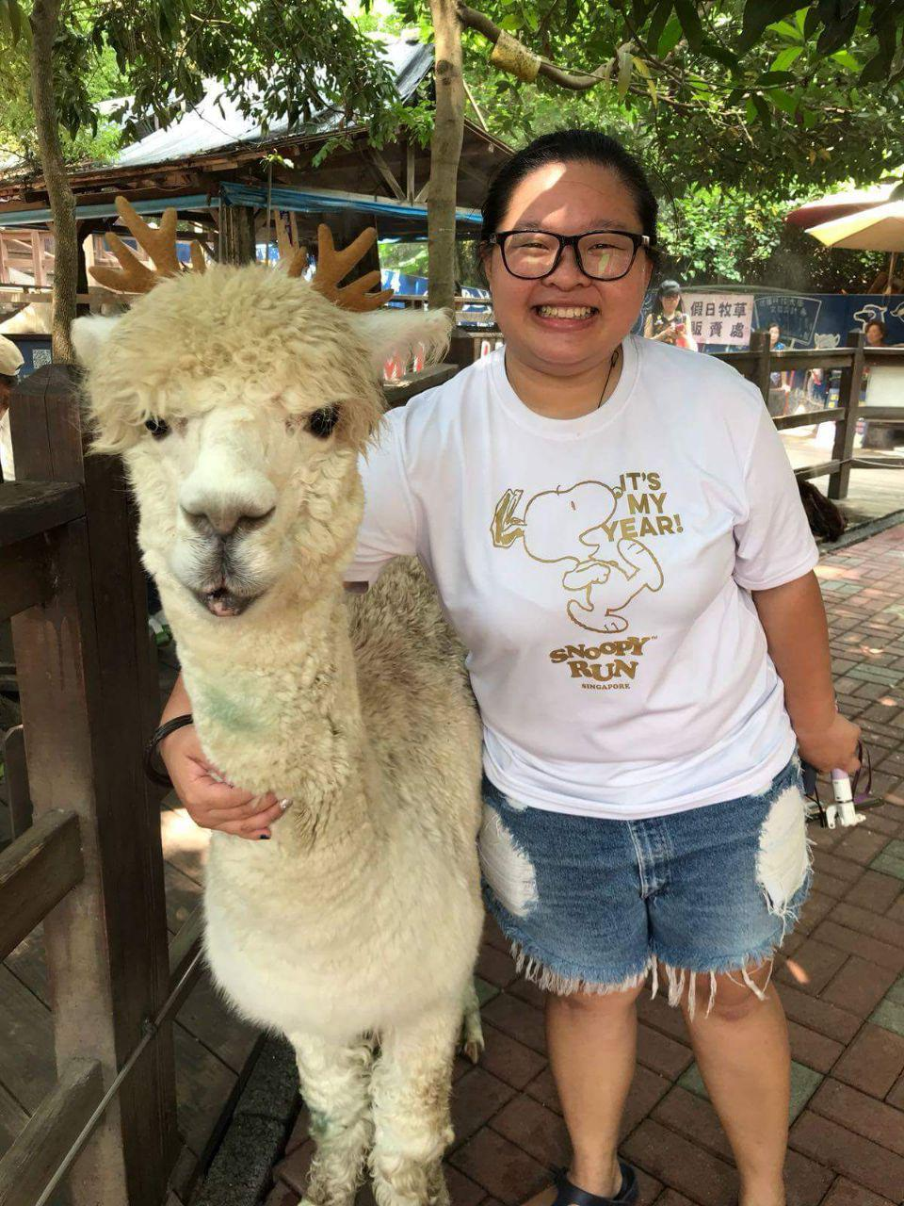
Yi jing back end developer
So many challenges, right from the start up till today! But yet, a very thrilling journey! Although my primary focus is the back end development, I still work hand-in-hand with the front end developers by giving the outward facing web application server-side logic. My role also requires me to manage the database, and with that, it allows me to get some pretty good exposure to it on a daily basis! I am now better able to manage a hosting environment, including the database. I am very happy with the progress that my team has made! Throughout this project, I don’t just develop skills, I don’t just develop the ability to learn, but I develop confidence as well! It is an enriching experience for me. I learn to preserve all the way and not give up. I learn that hard work always pays off. The feeling of accomplishing something is simply superb.

Slide 47
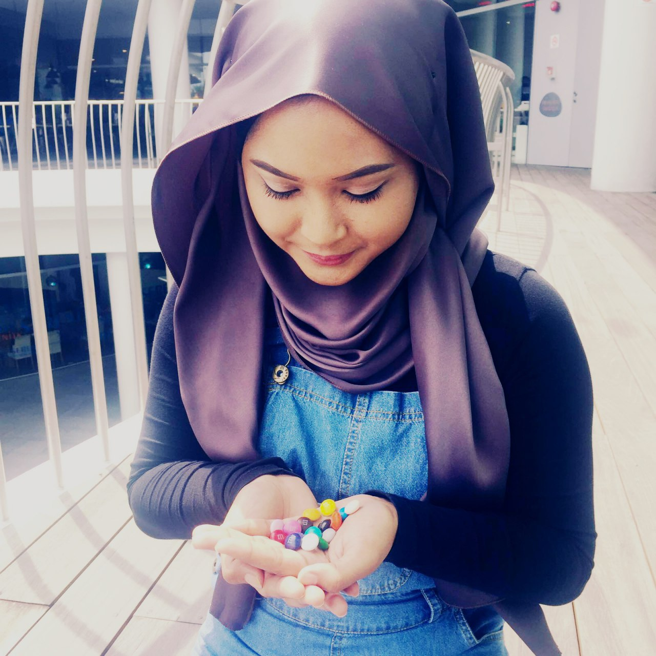
suhailah business analyst
What I have learnt throughout this project is that I need to move beyond just creating requirements specifications, analyze requirements or create visual models. I need to be more resourceful and grow my toolbox of skills, as a business analyst and a scrum master! From the start of the project, I always try to apply use cases in every requirements situation and this helps me gain more confidence to apply a wide variety of business analysis techniques. As I collaborate with the sponsor very often, I learn to apply my soft skills and analysis skills to create clarity for the project. I work closely with the Project Manager in ensuring that every sprint goals are met. When there are any feedback or new ideas that cannot be incorporated during the sprint, I have captured them as real backlog items and prioritized! The collection of critical information about the development process and my team’s effort then becomes the heartbeat of the team and helps set the cadence for each sprint!

Slide 48

THANK YOU
ANY QUESTIONS FOR US?

